Slide 1
Malaria, Other Infections including airborne diseases
By
Dr John S. Bimba
Department of Community Medicine
Bingham University

Slide 2
What is malaria?
Malaria is a life-threatening disease caused by parasites (Plasmodium sp.) that are transmitted to people by mosquitoes
An estimated 409,000 people were killed by malaria in 2019 globally
Children (<5 years) are the most vulnerable and account for 67% of malaria deaths
Approximately half the world’s population are at risk of the disease.
In 2019, 6 countries accounted for approximately half of all malaria deaths worldwide: Nigeria (23%)
9 out of 10 malaria deaths occur in Africa
Malaria is preventable and curable

Slide 3
What causes malaria?
Malaria is caused by a microscopic parasite called Plasmodium.
Four species (P. falciparum, P. malariae, P. vivax and P. ovale) of this parasite infect humans to cause malaria.
But Plasmodium falciparum is the most deadly.
Plasmodium is transmitted between people by blood-eating mosquitoes.
The mosquito is described as a malaria ‘vector’ because it spreads but doesn’t actually cause disease.

Slide 4
Cont.
To beat malaria, the immune system needs to be able to find Plasmodium.
But Plasmodium hides, first in liver cells and then in red blood cells.
This prevents the immune system’s white blood cells from finding and destroying it.
Plasmodium has a complex life cycle involving the infection and destruction of red blood cells

Slide 5
Symptoms of malaria
Initial symptoms :
Fever, headache, shivering, vomiting
In severe cases of Plasmodium falciparum malaria, these symptoms can develop:
Severe anaemia (lack of oxygen in blood), breathing difficulties, organ failure, problems with the nervous system

Slide 6
How is malaria diagnosed?
To look at samples of a patient’s blood down to a laboratory for microscope or Rapid kit test.

Slide 7
How can malaria be prevented?
The main way of preventing malaria is to target mosquitoes by:
Reducing areas of standing water where mosquitoes breed
Using insecticide-treated bed nets that help prevent mosquitoe bites
Spraying houses indoors with insecticides that kill mosquitoes when they land

Slide 8
How is malaria treated?
Quick diagnosis and treatment of malaria with anti-malarial drugs prevents deaths and reduces transmission.
– artemether–lumefantrine
– atovaquone–proguanil
– dihydroartemisinin–piperaquine
– quinine plus doxycycline or clindamycin.
But the cost of such drugs and the development of resistance by Plasmodium poses challenges.
Ideally, we would prevent people from getting malaria in the first place.

Slide 9
Vaccines could help prevent malaria
A malaria vaccine would train the immune system to find and destroy Plasmodium before it does any damage.
The most promising vaccine being researched is called RTS,S and is currently being tested to see how safe and effective it is.

Slide 10
Link between Malaria and Airborne disease
Mode of Transmission of disease
Direct
Direct Contact
Droplets
infection
Indirect
Airborne
Vehicle
borne
Vector borne

Slide 11
Other Airborne diseases
What is Airborne disease?
Airborne infection is defined as “A mechanism of transmission of an infectious agent by particles, dust, or droplet nuclei suspended in the air

Slide 12
Examples of Airborne diseases
Typical pulmonary infections acquired due to inhalation of infectious aerosols include: Tuberculosis, Influenza, Legionellosis, Histoplasmosis, Q fever , occupational lung diseases, COVID-19 etc

Slide 13
TUBERCULOSIS (TB)

Slide 14
WHAT IS TB
Tuberculosis is caused by a germ (bacteria) known as Mycobacterium tuberculosis
It mainly affects the lungs (Pulmonary TB) but can also affect other organs such as bone, kidney, brain tissue etc.
TB outside the lungs is called ‘Extra Pulmonary TB’

Slide 15
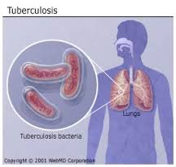

Slide 16
HOW IS TB TRANSMITTED
TB germs are released into the air when a person with TB of the lungs who is not on treatment coughs or sneezes.
A healthy person can become infected with TB when s/he breathes in TB germs circulating in the air.
Such an infected person with TB may later develop TB disease.

Slide 17
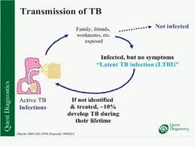

Slide 18
RISK OF TRANSMISSION
Overcrowding
Inadequate ventilation
Contact with a TB patient who is not on treatment

Slide 19
KEY RISK FACTORS FOR PROGRESSION OF TB INFECTION TO TB DISEASE
HIV/AIDS
Malnutrition
Chronic diseases like diabetes mellitus, various types of cancer, etc.
Immunosuppressive drugs like prolonged use of steroids
Extremes of age (very young children and the elderly)

Slide 20
WHO IS PRESUMPTIVE TB CASE
Any anyone who presents with signs and symptoms of TB.
The commonest symptom of TB is persistent cough lasting two or more weeks.
Other symptoms of TB may include, chest pain, breathlessness/difficulty in breathing, coughing up blood, weightloss, tiredness, fever, night sweats and loss of appetite

Slide 21
HOW TO MAKE THE DIAGNOSIS OF TB
TB can be diagnosed by a combination of symptoms, physical examination and investigations
PTB is commonly diagnosed by testing sputum specimen in the laboratory (Sputum smear microscopy) or presently using,
GeneXpert test which is a relatively new, faster, more sensitive test for diagnosis of TB. Results can be obtained within 2 hours.
Other method of diagnosis is Culture which is the Gold standard but, takes longer time.

Slide 22
HOW CAN TB BE PREVENTED
Ensure any person with cough observes basic infection control practices such as:
covering of nose and mouth with handkerchiefs when coughing or sneezing
avoid spitting indiscriminately and dispose sputa properly
wash hands after coughing or sneezing
Ensure TB patients are promptly diagnosed and put on appropriate treatment for the right duration
BCG vaccination can prevent severe forms of TB especially in children

Slide 23
COVID-19 DISEASE

Slide 24
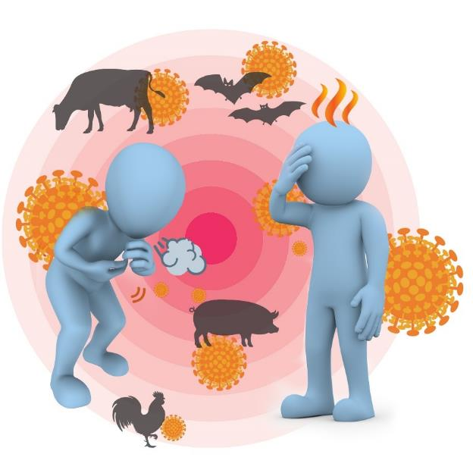
Severe acute respiratory syndrome coronavirus 2 (SARS-CoV-2) causes COVID-19
SARS-CoV-2 is a new virus.
The first cases were identified in people with pneumonia in Wuhan, China, in late December 2019.
It probably started in animals but is now spreading between people.
As this virus is new, we are learning more all the time, and what we know now may change.

Slide 25

COVID-19 pandemic
The World Health Organization (WHO) declared the situation a pandemic on 11 March 2020 signifying
Widespread human-to-human transmission
Large number of affected countries
Although there is a lot we don’t know yet about this new virus, we can still prevent the disease.

Slide 26
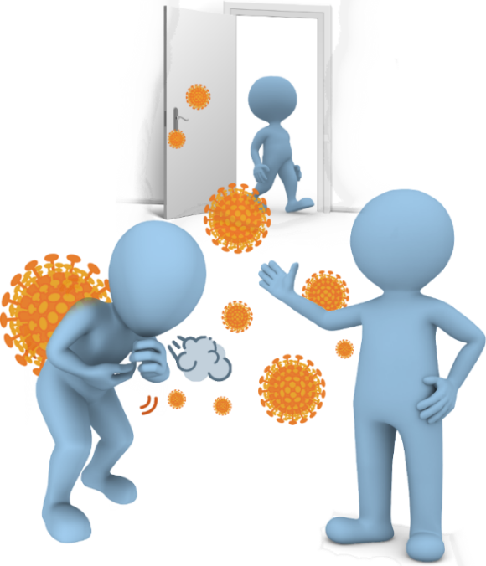
How is COVID-19 spread?
Most people are being infected from other people, when in close contact (within 2 metres or 6 feet).
It spreads through droplets created when we talk, cough, sing, sneeze or breathe heavily.
These droplets enter the nose, eyes or mouth or when the infected droplets are inhaled.
In indoor spaces with inadequate ventilation, COVID-19 has spread to people who were more than 2 metres or 6 feet away.
Touching contaminated objects puts the droplets onto your hands. If you touch your face the droplets can enter your nose / eyes / mouth.
Infected people with minimal or no symptoms can spread COVID-19.

Slide 27

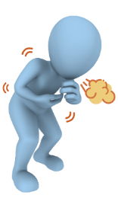
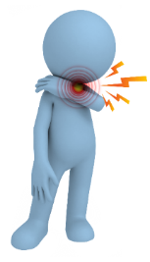


Symptoms start like many other illnesses
Common symptoms include:
Fever
Cough
Sore throat
Fatigue
Shortness of breath
Symptoms start about one day after exposure, but can be as long as 14 days. Most people develop symptoms within 5-6 days.

Slide 28


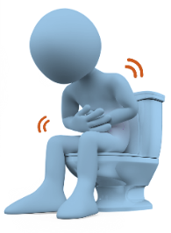
It can also cause many other symptoms, including
Headache / muscle aches
Sudden loss of sense of smell and taste
Runny/stuffy nose
Nausea, vomiting, diarrhoea
Rash
Some people have no symptoms, most have a mild illness. It can be severe and sometimes fatal.
Many patients recover fully in about 2 weeks. In others, some symptoms like breathlessness, fatigue may continue for weeks and months.

Slide 29

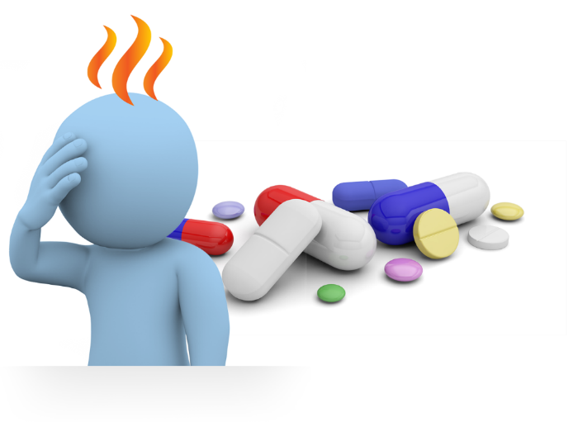
Diagnosis and treatment
Because symptoms are similar to many other illnesses, tests are needed to make the diagnosis (nose/ throat swab, blood test).
There is no specific treatment. Several trials are underway.
Mild symptoms can be treated at home with medicines to lower the fever, or relieve pain.
If symptoms are more severe, treatment in hospital is required.

Slide 30

Prevention
Reduce the spread of infection
Wear a face mask (or cloth covering nose and mouth) in when in public, especially when it is not possible to keep 1-2 metres (3-6 feet) away from others.
If you have any symptoms even if only mild, stay home. Seek medical advice following local guidelines.
Wash your hands frequently with soap and water.
Use alcohol-based hand sanitiser when soap and water are not readily available.
Cover your coughs and sneezes. Do not use your hands, instead use a tissue or your upper sleeve. Immediately throw the tissue in a bin and wash your hands.
Some countries have started vaccination among priority groups.

Slide 31

Prevention
Reduce the spread of infection
Avoid touching shared objects (light switches, handrails, door handles etc) as much as possible. If you must touch such objects, wash your hands or use sanitiser promptly afterwards. Ensure you do not touch your face.
Clean and disinfect frequently touched surfaces each day, more often if you think they’ve been contaminated. Use normal cleaning supplies.
Do not share food, drinks and personal items including mobile phones.
Do not travel if you are sick.

